Slide 1
Smart Helmet Detector: Detecting if construction workers wear helmets using AI.
Student: Koffi Viglo and Erwin Cheng Course: ITAI 1378- Comp Vision-Artificial intel

Slide 2
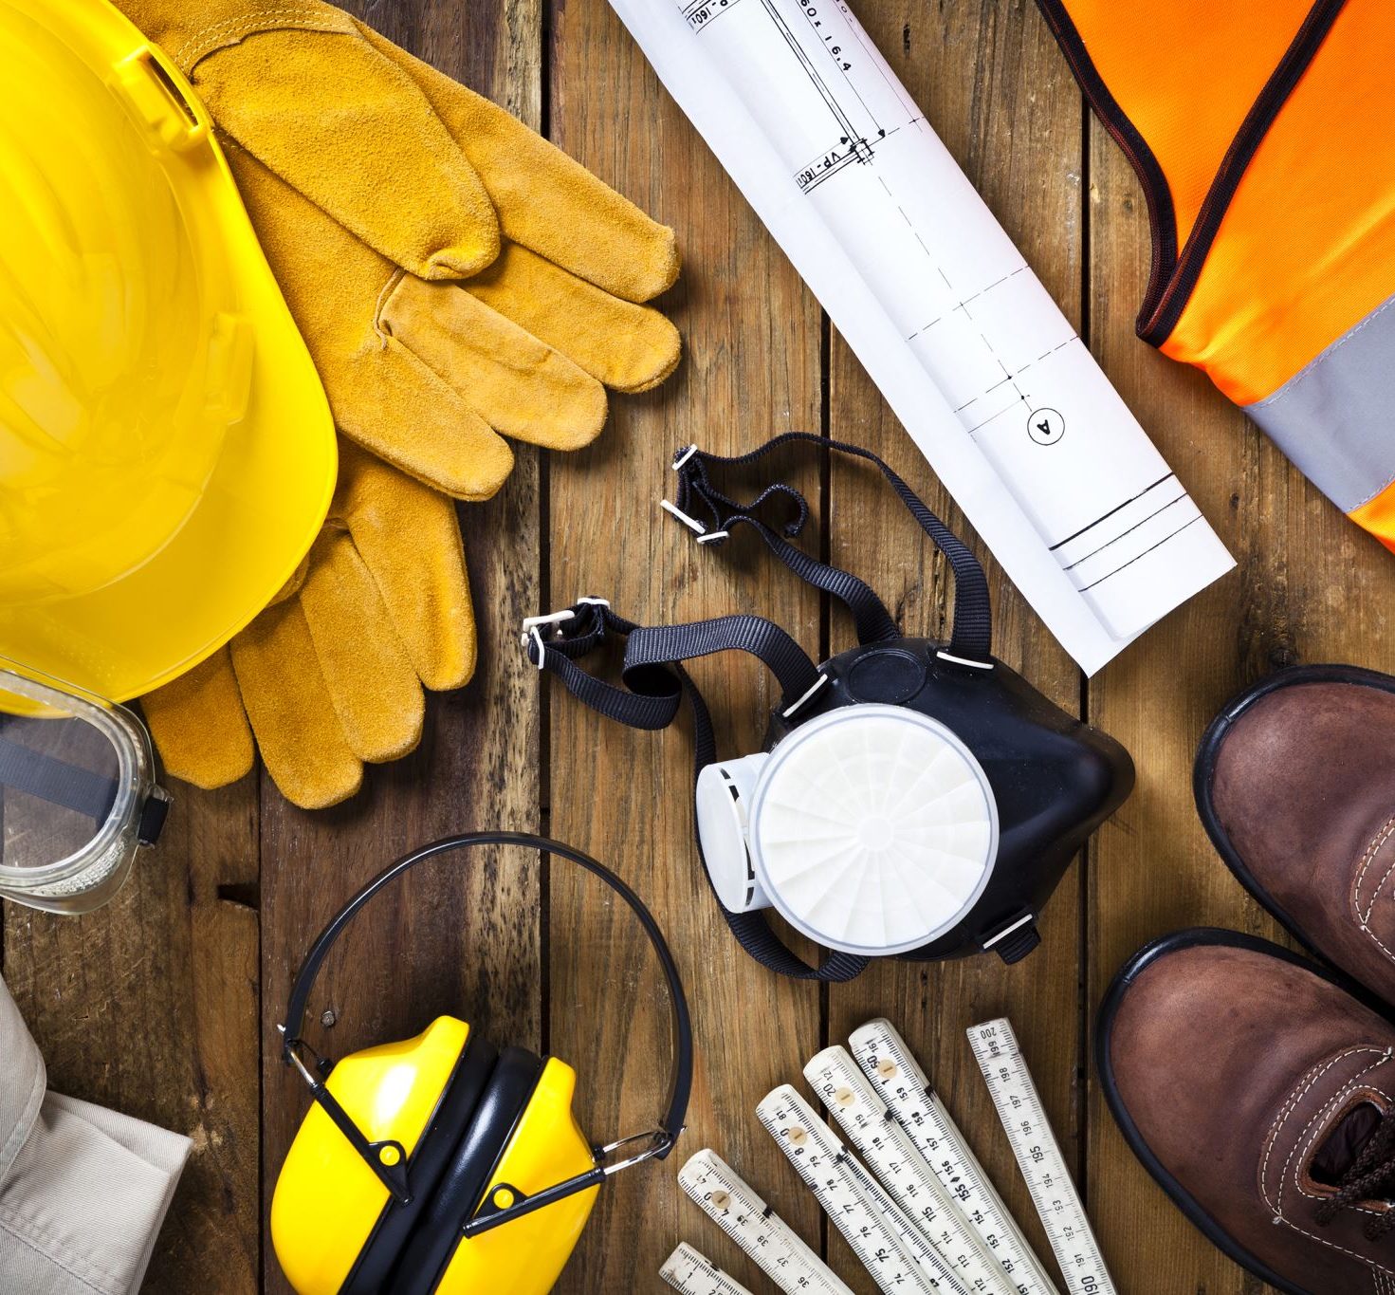
Problem
Many construction workers forget or refuse to wear helmets. This leads to serious head injuries and even fatal accidents. Supervisors can’t monitor every worker all the time. We need an automated safety system to detect who is not wearing a helmet.

Slide 3

Proposed Solution
Build an AI-based camera system that:
Uses object detection to identify people and helmets.
Alerts supervisors if a worker is seen without a helmet.
Can be used on construction sites or industrial areas.

Slide 4
Technical Approach
Use YOLOv8 (You Only Look Once) for real-time object detection.
Train the model using helmet detection datasets from Roboflow.
Run and test the model on Google Colab using Python.
Evaluate accuracy and detection speed.

Slide 5
Data Plan
Dataset source: Roboflow public “Safety Helmet Detection” dataset.
Contains images of workers with and without helmets.
Data will be preprocessed and split into train/test sets.
Augmentation: resize, flip, adjust brightness.

Slide 6

Slide 6: System Diagram
It will be:
Camera → YOLOv8 Model → Detection → Alert (No Helmet)
Simple pipeline:
Capture image/video.
Detect person and helmet.
Compare bounding boxes.
If person has no helmet → send alert.

Slide 7

Success Metrics
Accuracy: at least 85% detection rate.
Speed: real-time detection (under 1 second per frame).
Precision: few false alarms.
Reliability: works in different lighting conditions.

Slide 8

Week-by-Week Plan
Week 1: Research and gather dataset. Week 2: Set up YOLOv8 in Colab and train on sample data. Week 3: Evaluate results and test images. Week 4: Prepare slides, GitHub repo, and finalize project report.

Slide 9
Challenges and Backup Plan
Challenges:
Small dataset or low accuracy.
Slow detection on low-end hardware.
Backup Plans:
Use pretrained YOLO model.
Reduce image resolution for faster results.
If data fails, use Kaggle dataset.

Slide 10
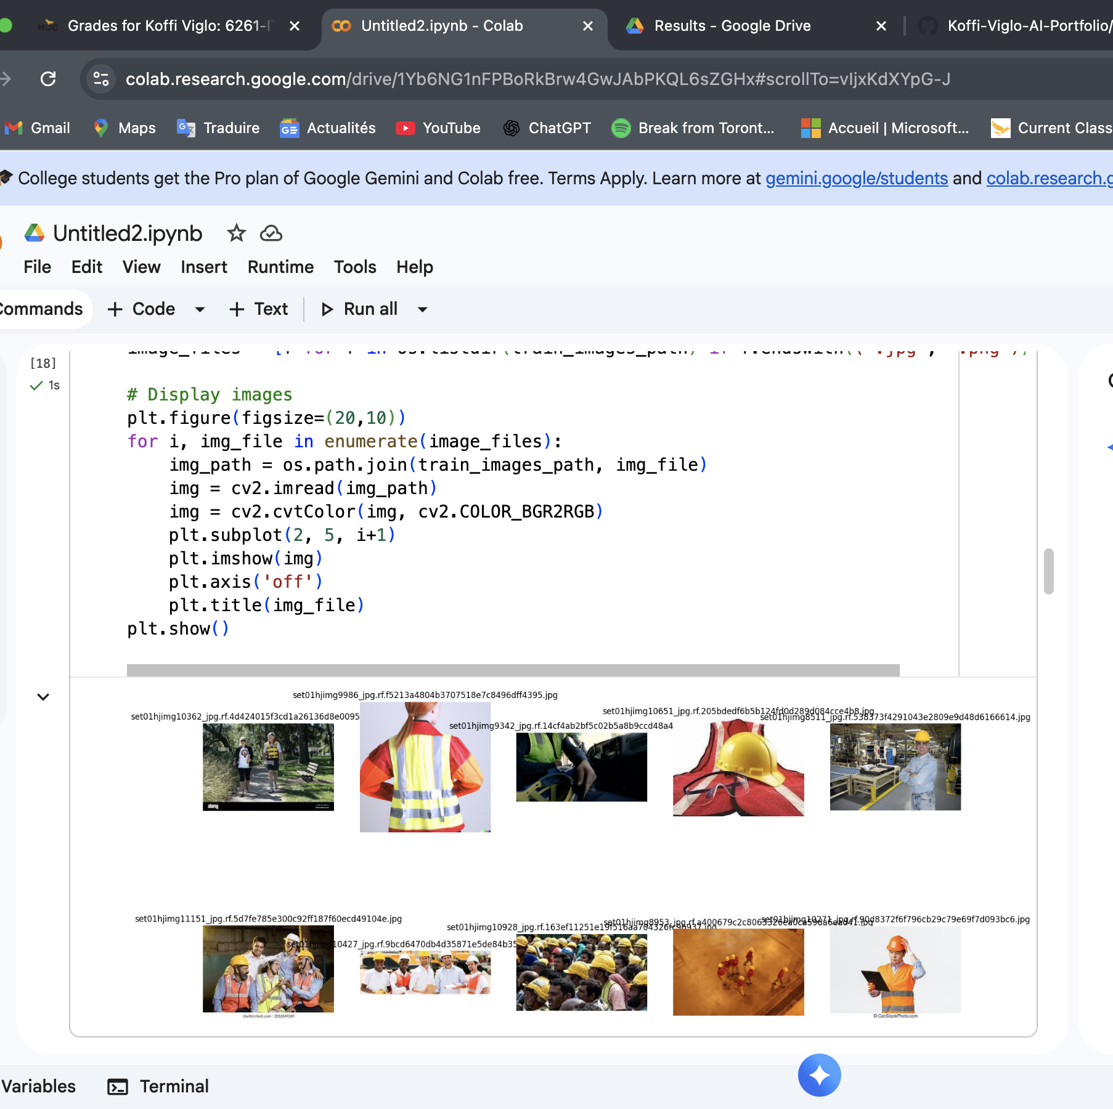
Visualizing Sample Training Images
This slide shows a few sample images from our safety helmet and reflective jacket dataset. We display 10 images to give an idea of the variety in the dataset, including different people, helmets, and jackets. This helps us understand what the model will learn from during training.

Slide 11
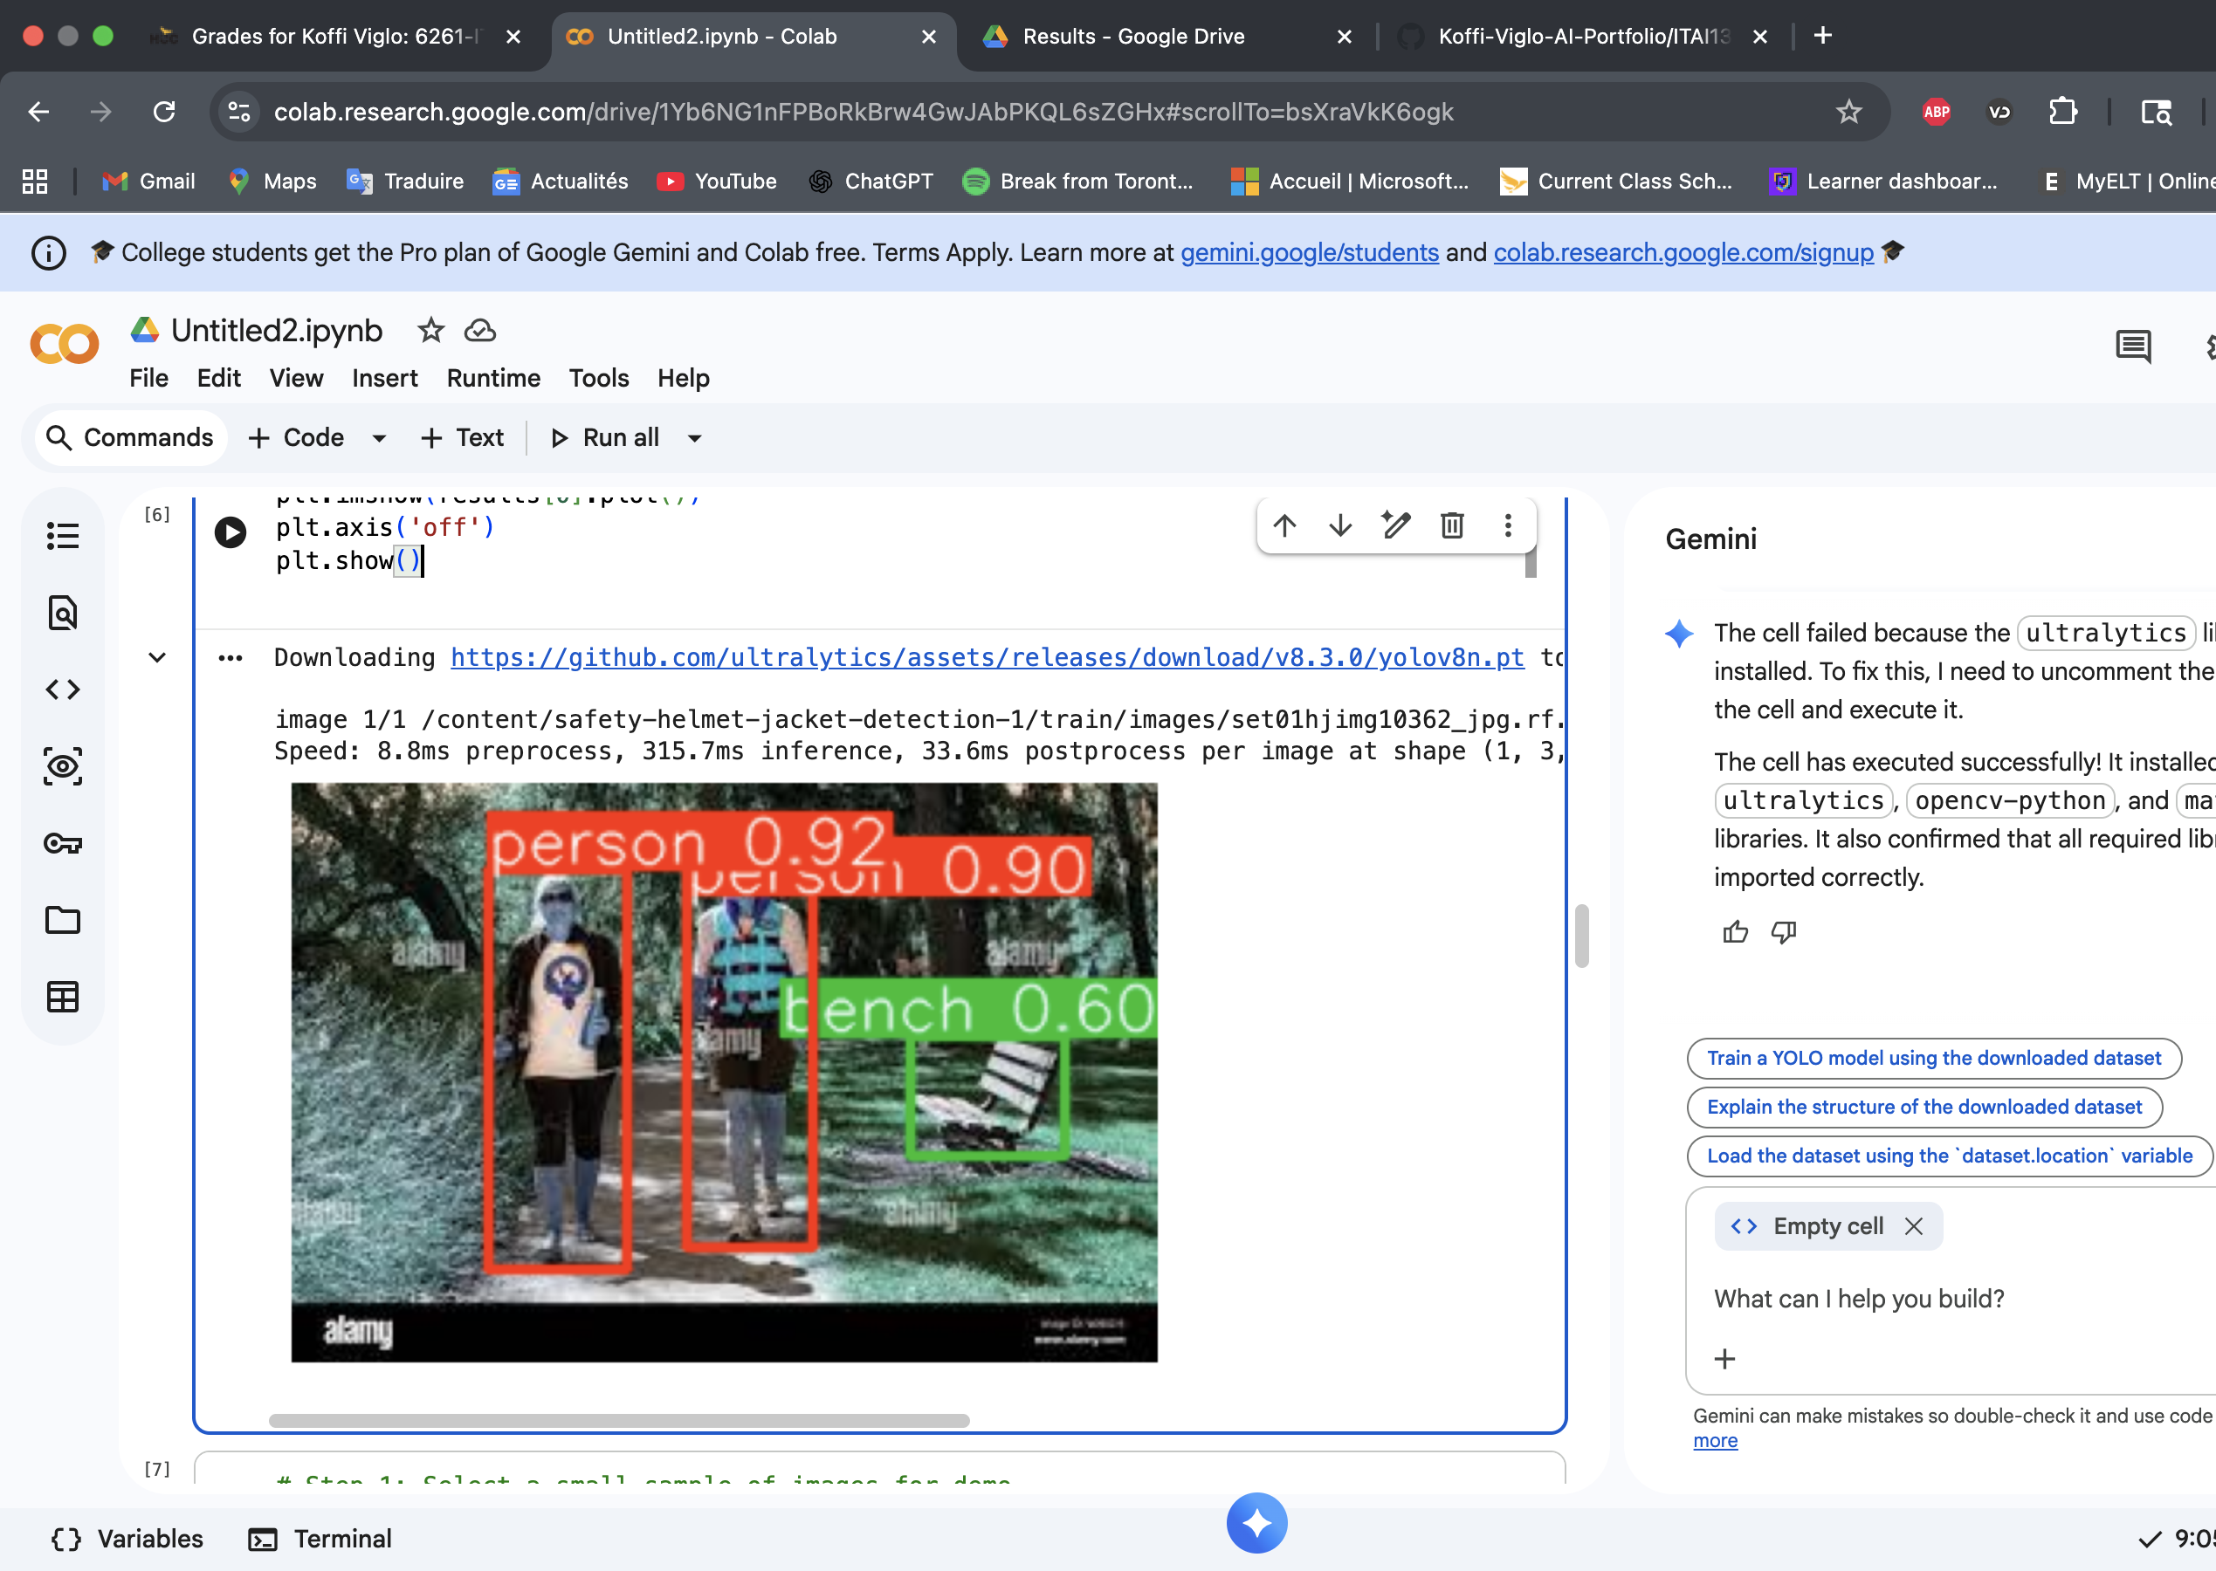
Test Inference with YOLOv8
We loaded a pre-trained YOLOv8 model and ran it on one sample image. The model detected objects like people, helmets, and reflective jackets. The image shows the detected objects with bounding boxes, giving a quick check that the model works before training.

Slide 12
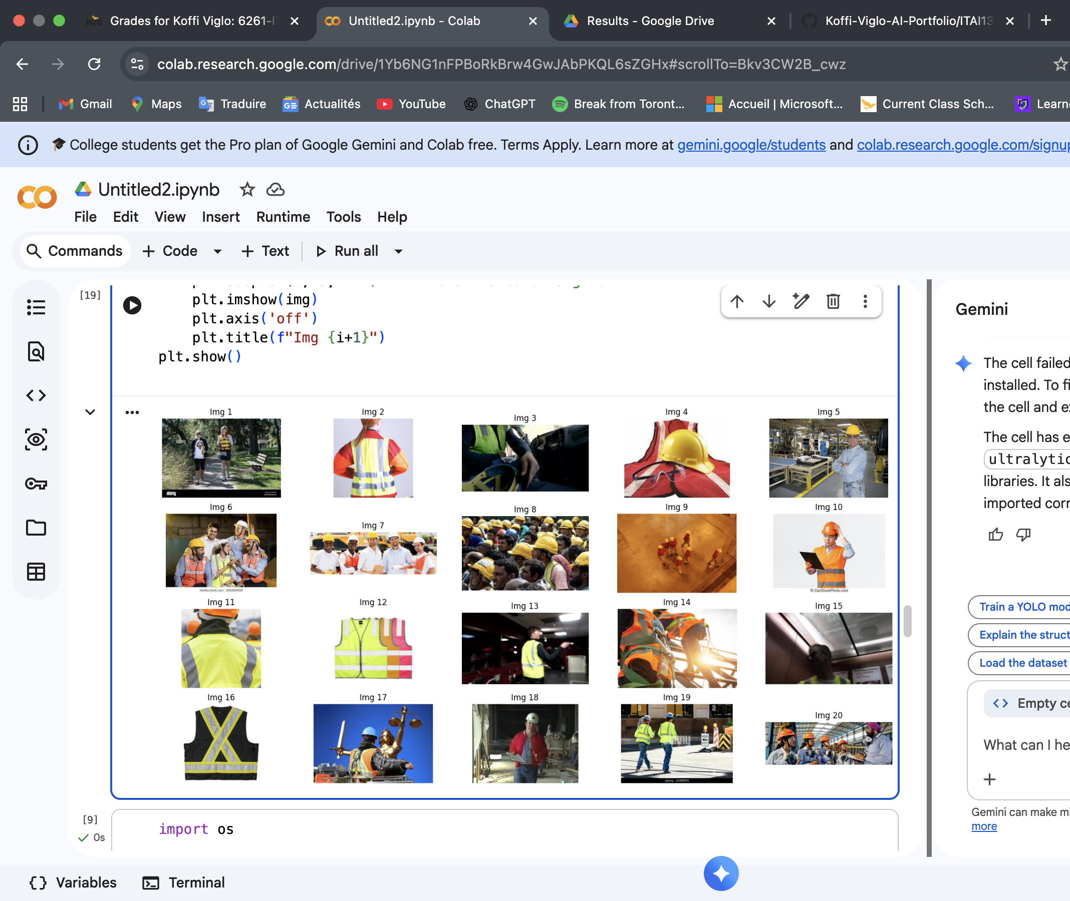
Select Sample Images for Demo
We selected 20 sample images from the dataset to use for model testing and demonstration.

Slide 13
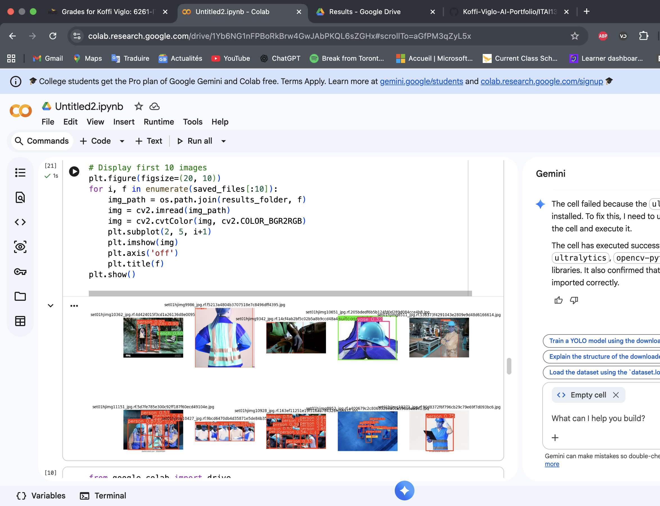
Display Saved Detection Results
This slide shows how the model identified objects in the images and saved the outputs.

Slide 14
Resources Needed
Laptop with internet access.
Google Colab (free GPU).
Roboflow dataset access.
YOLOv8 framework (Ultralytics library).
GitHub for documentation.

